Slide 1
Cross Platform Application Development
For Real Time Transparency System

Slide 2

Introduction
Requirements Analysis
Designing and Development
Project Flow
Project Integration
Future Implementations
Post Project Training
IOT : Internet of Things
Cyber Security
Django
AWS : Amazon Web Services
Skills Training
Application User Interface

Slide 3
1.Introduction
What exactly is Transparency ?

Slide 4
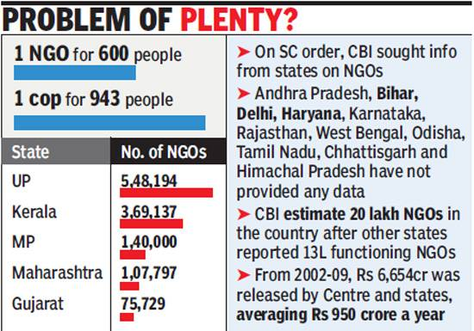
Introduction
A Framework for NGO’s to follow 100% Transparency for each of their functionalities.
For any NGO, or a social unit or an Organization, financial transparency has become the prime concern and requirement.
Framing a challenge, the concept of 100% transparency is to be brought forward. And financial transparency has been focused as the first stage.
An attempt has been made to develop a system which is totally transparent in terms of both monetary and functional aspects.
As per the statistics of 2009 survey, there are 2 million NGOs in India.
Which implies, For every 600 persons, there is an NGO.
Statistics : 2009, Times of India

Slide 5
2. Requirements Analysis
SDLC – RAD Model
Technologies Used
Why React ?

Slide 6
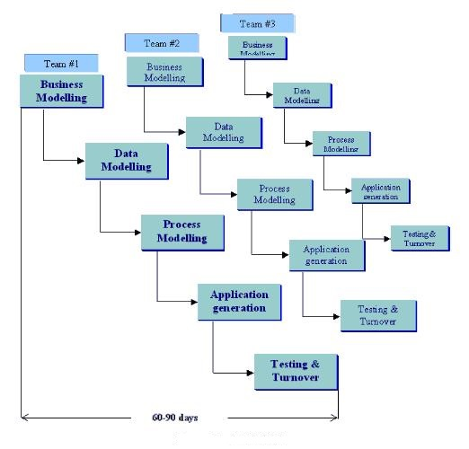
Rapid Application Development Lifecycle
Based on prototyping and iterative development with no specific planning involved.
Rapid Application development focuses on gathering customer requirements through :
Workshops or focus groups,
Early testing of the prototypes by the customer using iterative concept,
Reuse of the existing prototypes,
Continuous integration and rapid delivery

Slide 7
RAD Model - Pros and Cons
Pros | Cons
Changing requirements can be accommodated.
Iteration time can be short with use of powerful RAD tools.
Productivity with fewer people in short time.
Reduced development time. Increases reusability of components
Suitable for project requiring shorter development times.
Only system that can be modularized can be built using RAD.
Requires highly skilled developers/designers. High dependency on modeling skills.
Management complexity is more.
Suitable for systems that are component based and scalable.

Slide 8






Technologies Used
React Js
Twitter Bootstrap
Ajax
Flux Architecture
CSS 3
HTML 5

Slide 9
HTML5 & CSS3
A single markup language that can be written in either HTML or XHTML.
It extends, improves and rationalizes the markup available for documents.
CSS3 used for describing the look and formatting of a document written in a markup language.
Twitter Bootstrap
Bootstrap is a free and open-source collection of tools for creating websites It aims to ease the development of dynamic & responsive websites and web applications.
Ajax
It allows web pages to be updated asynchronously by exchanging small amounts of data with the server behind the scenes.

Slide 10

Why React Js?
React was built to solve one problem :
“building large applications with data that changes over time ”.
Virtual DOM : When the data changes, React conceptually hits the "refresh" button, and knows to only update the changed parts.
Better Performance :
AngularJS takes 1.35 sec. to show lists of 1500 rows whereas it is 310ms with ReactJs .
React is Simple :
Simply express how your app should look at any given point in time, and React will automatically manage all UI updates when your underlying data changes.
Build Composable Components
React is all about building reusable components. In fact, with React the only thing you do is build components. Since they're so encapsulated, components make code reuse, testing, and separation of concerns easy.

Slide 11
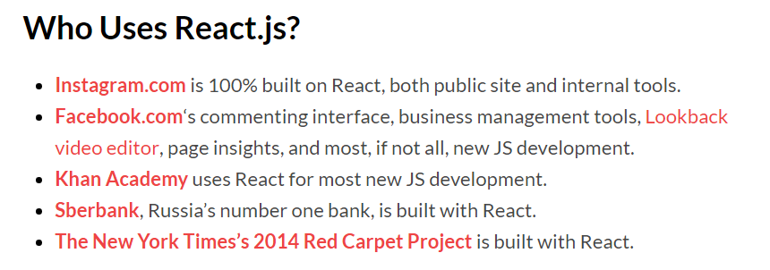





Slide 12
3. Designing and Development
Flux Architecture

Slide 13
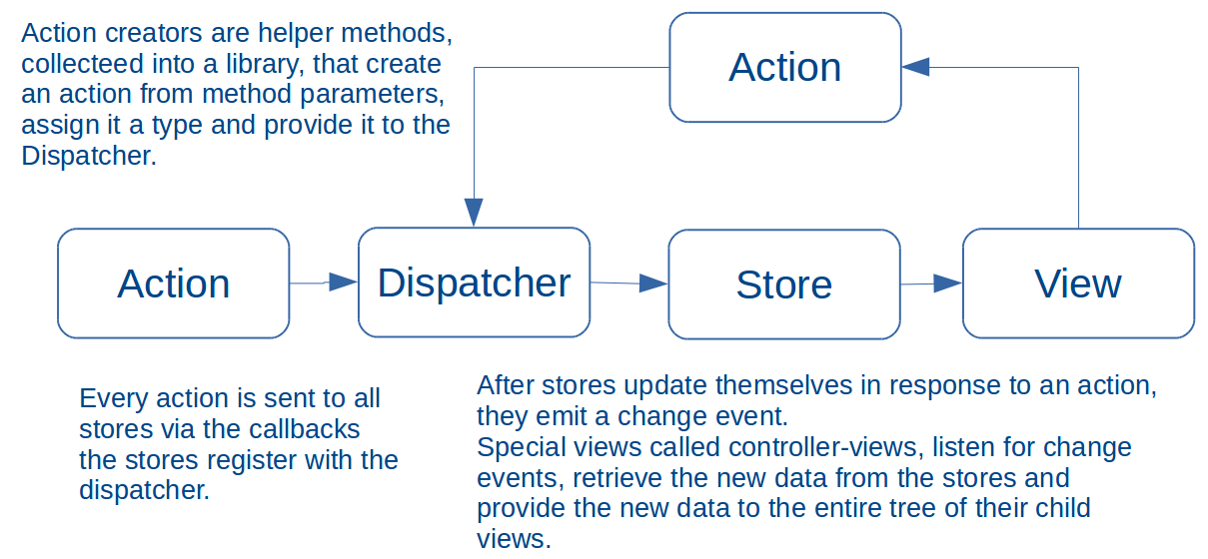
Flux Architecture
Flux is the application architecture that Facebook uses for building client-side web applications.
It complements React's composable view components by utilizing a unidirectional data flow. It's more of a pattern rather than a formal framework.

Slide 14
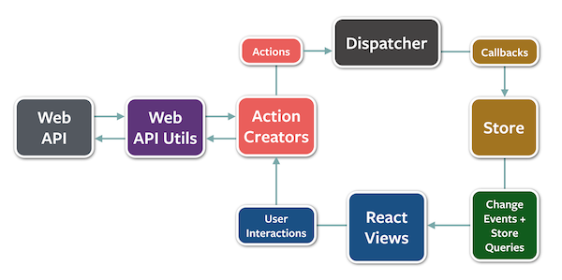
Project flow using Flux architecture

Slide 15
4. Project Flow
The What and The Why

Slide 16
Overall View Of The Project
Permanent Navigation Bar
Home Page
Information and Introduction of the Organization
About Us
Campaign
Pledge
Transparency Module

Slide 17
Login Module
Card System
Login
OTP
Process
LOGIN WITH PHONE OTP
Activity
Each card is packed with the monetary for the user to DISCUSS or SUGGEST or PARTICIPATE or just VIEW

Slide 18
Contents of Transparency Module
Monetary
Policies
Items
Donations
Details
Tasks
Surveys
Polls
Discussions
Tasks
Discussions
Survey
Ratings
Polls

Slide 19
Monetary
Policies
Items
Donations
List of Policies adopted to maintain transparency in the NGO
Pens
Pencils
Bed-sheets
Boxes
Notebooks
FOOD
EDUCATION
MEDICAL
GENERAL

Slide 20
5.Example Components
DOM Vs Virtual DOM
Comments Box Sub-module
Scrollable Interface Using React-infinite

Slide 21
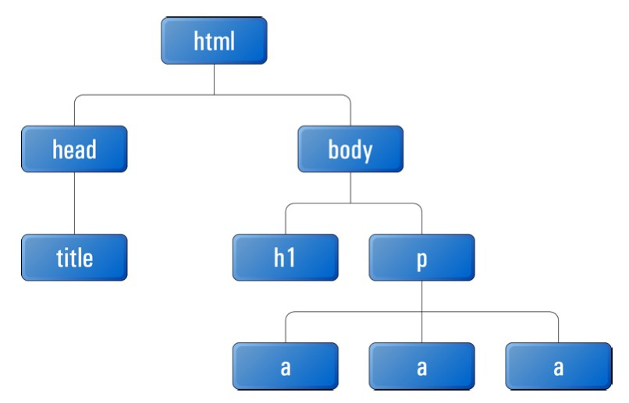
The Concept of Virtual DOM
What is DOM ?
What if DOM element changes?
What is Virtual DOM?
Example :

Slide 22
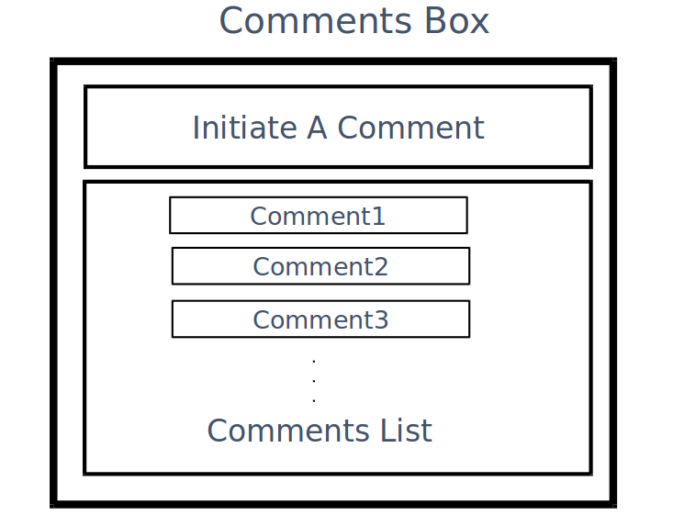
Comment Box Module
Comment Box
Initiate a comment
Comment list
Comments
Comment Box
Initiate a comment
Comment list
Comments

Slide 23
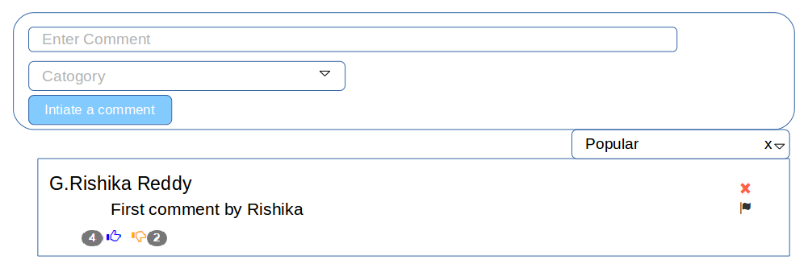
Comment Box Module

Slide 24
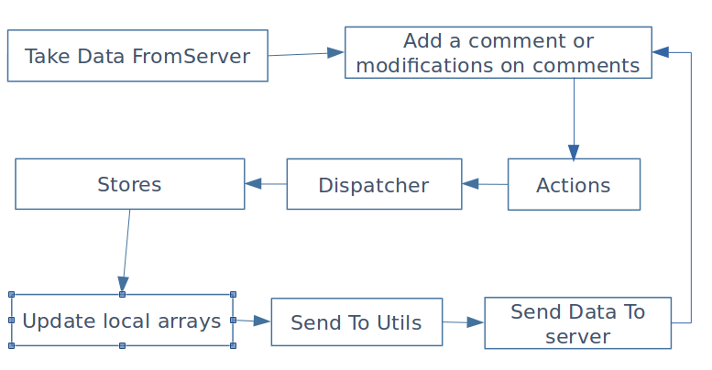
Data Flow : Comment Box

Slide 25

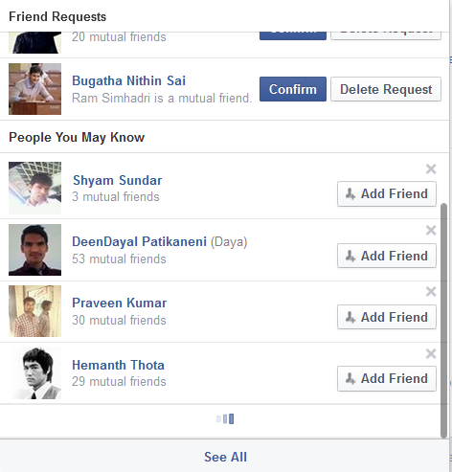
Pagination (Scrollable Interface)
Developed methods
Normal Scrolling Method
An EventListener function
When scrolls down to the bottom, loads some more data
Previous DOM nodes are not removed while scrolling down
React-waypoint plugin
Based on waypoint
Previous DOM nodes are removed while scrolling down,
React-Infinite plugin
All other elements are kept in DOM even if scrolled out of user’s view
Advantages
Reduces complexity
Improve readability

Slide 26
6. Project Integration
Integration Issues and Challenges

Slide 27
Problems Faced During Integration
Server Calls : When Every one making individual components there is no need to trigger for actions
to make server calls. But in Integration a server call should be done only when
particular action is triggered.
View styles : As some of us implemented same components, they added own styles for default
classes of bootstrap . It leads to altering views of overall other components.
React Routing : This is the major problem we came across.
How we resolved them
Server Calls : We used generic call back functions.
View styles : Naming distinct id and class names as attributes for various html tags.

Slide 28
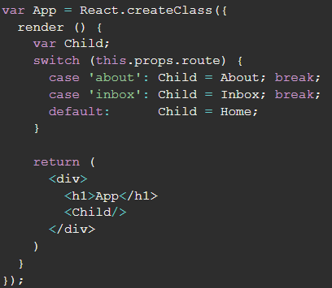
Routing Issues:
If <Discussion> has some nested UI at a path like Ngo/discussion/:id
For example : url hash is
Ngo/discussion/1
Ngo/discussion/2
etc.….,
In order to know which URL-mapped child component it should render. We'd then have a branch of components that should be rendered at any given URL.

Slide 29
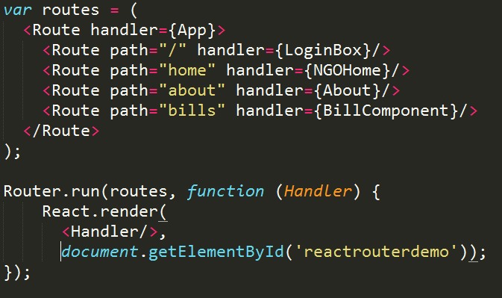
React Router
React Router is a complete routing solution designed specifically for react js.
It painlessly synchronizes the components of our application with the URL.
React Router supports for nesting, transitions, and server side rendering.

Slide 30
7. Future Implementations
Applications and Possibilities
Upgradations

Slide 31
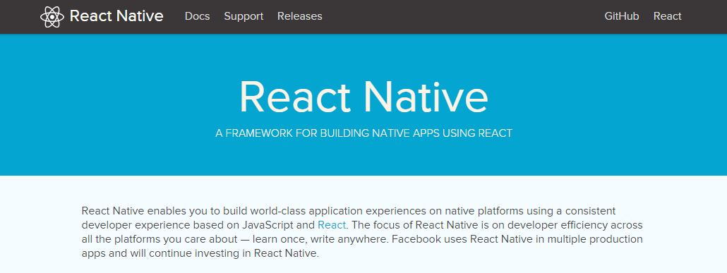
Future implications:
React Native
Single technology for Multiple Application Platforms
Real Time Web Development
Pull based
Push Based

Slide 32
Upgradations
Online Donations
Petition Signing (e.g. https://change.org)
A framework to be implemented not just for a single NGO, but for all functional and structural organizations

Slide 33
Post Project Training
Other Technical Fields of Training

Slide 34
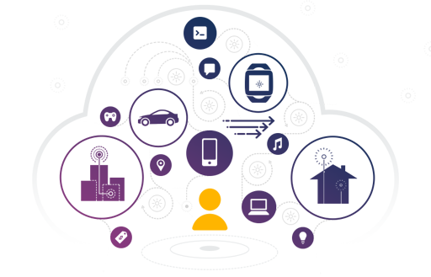
IoT : Internet of Things
The Future of Internet and Things

Slide 35
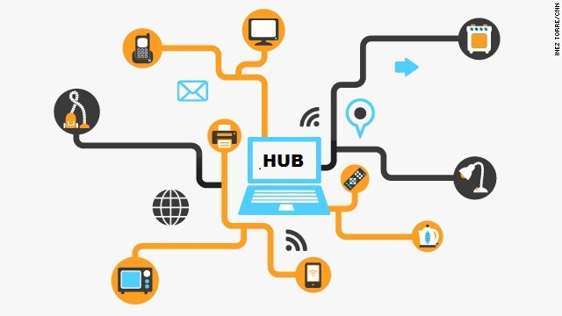
IoT : Internet of Things
Introduction
Things connecting to internet. E.g. : Fitness band
IOT Framework
Things are connected to HUB/BRAIN
Project : Automatic Lights ON/OFF
Door Sensor, Light Sensor
Raspberry pi2 Model2
Future Implementation

Slide 36

Cyber Security
“Security Is Everyone’s Concern, But It Is OUR Responsibility”

Slide 37
Tool for
Idea
Create Defensive Idea
Tool for Attack Idea
Creating an Attack Idea
Existing attacks & methodologies
Pushing technology towards doing more than what it is meant to do is “HACKING”
Offensive mindset plays key role in Hacking
Responsible Hacking for Adaptive Security

Slide 38
Offensive Hacking Framework
Know What You Are & Know What Your Enemies Are
Intelligence Gathering
Exploits and Attacks
Post Exploitation
Traces, Anonymity and Privacy
Vulnerability Analysis

Slide 39

Django
REST Framework and Applications for Backend Development

Slide 40
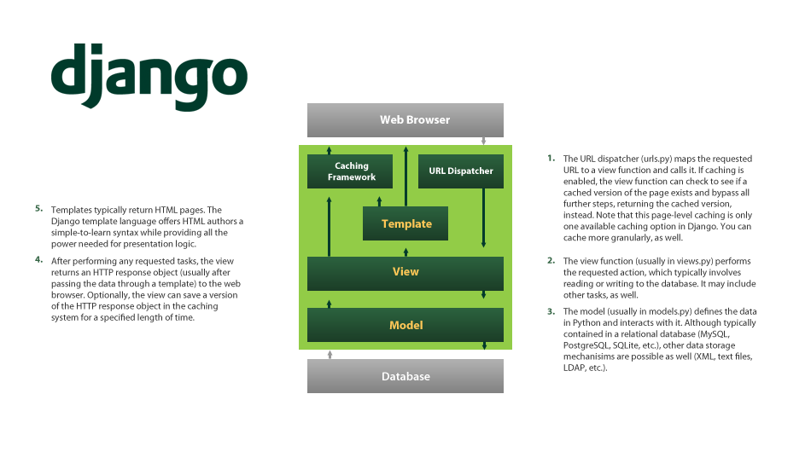
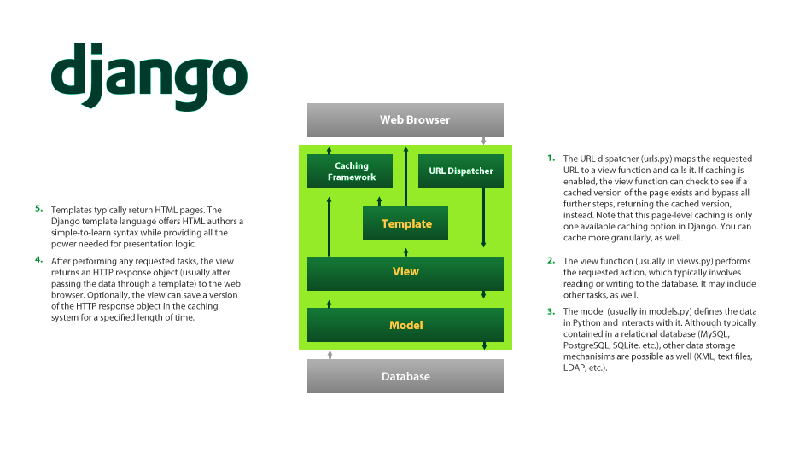
Django is a high-level Python Web framework that encourages rapid development and clean, pragmatic design.
We used this technology for common backend server instead of using several servers for android, iOS, cross platform.
Fast, secure, scalable & easier to build better Web apps more quickly and with less code
Uses Json Object format to access data servers
Used by NASA, Pinterest, Instagram, quora, BitBucket etc.

Slide 41


AWS : Amazon Web Services

Slide 42
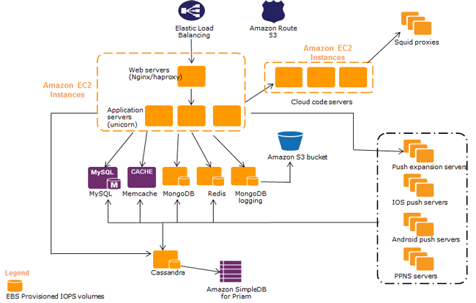
AWS Basic Framework
Cloud Computing service in order to host & store our application content in the cloud.
Aws : cloud-computing platform offered by Amazon.com
AWS offers reliable, scalable, and inexpensive cloud computing services.
Some popular products like EC2, Lambda, Cloud Front, RDS, Route53 etc..
AWS hosts platforms like Netflix, Expedia, Reditt, Adobe Systems, Pinterest etc.

Slide 43
Application User Interface
http://maketheworldwonderful.org

Slide 44
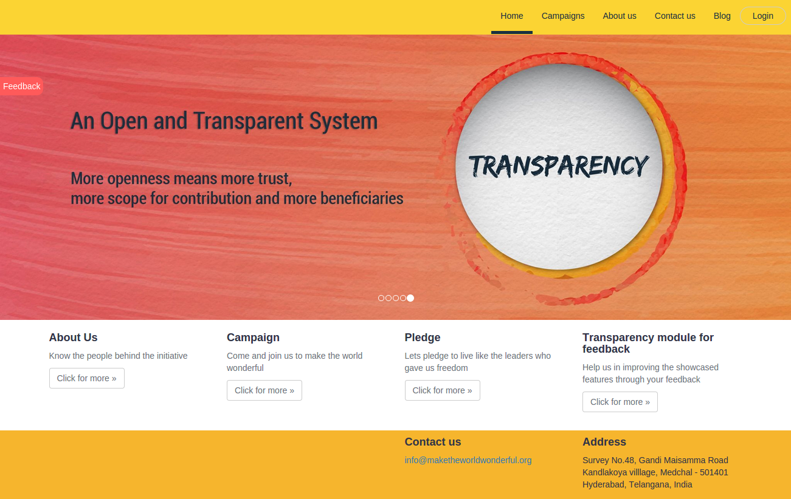
Application User Interface
http://maketheworldwonderful.org

Slide 45
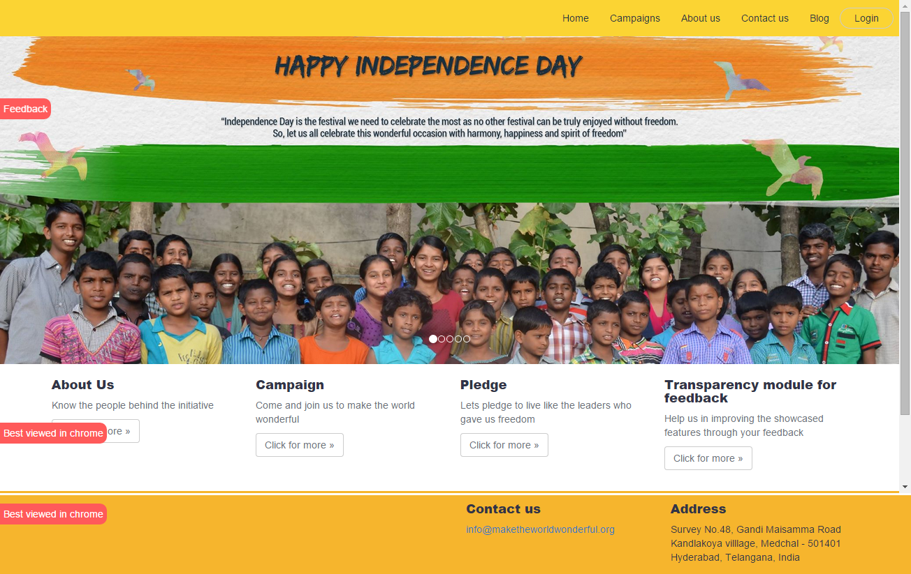
Application User Interface
http://maketheworldwonderful.org

Slide 46
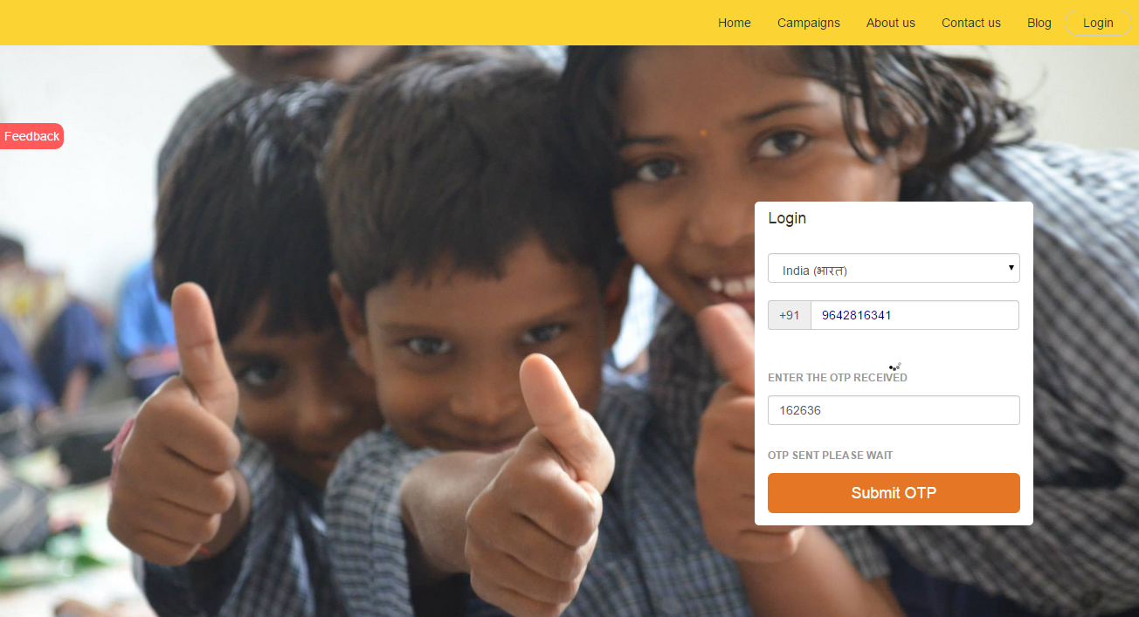
Place your screenshot here
Application User Interface
http://maketheworldwonderful.org

Slide 47
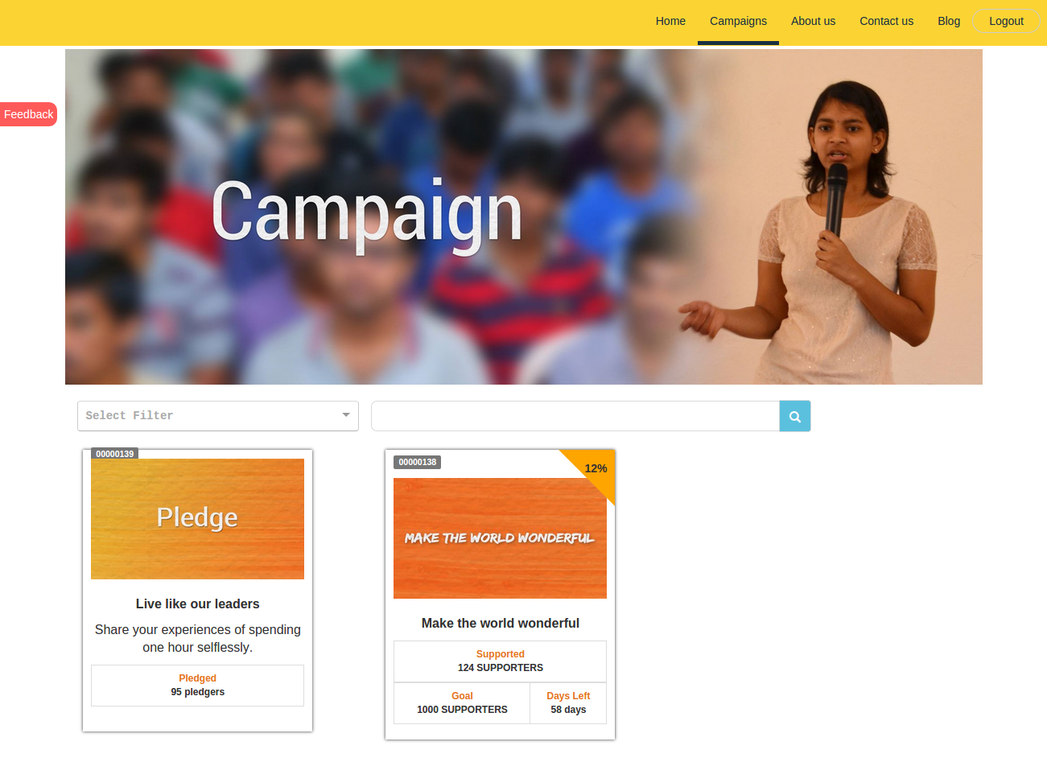
Application User Interface
http://maketheworldwonderful.org

Slide 48
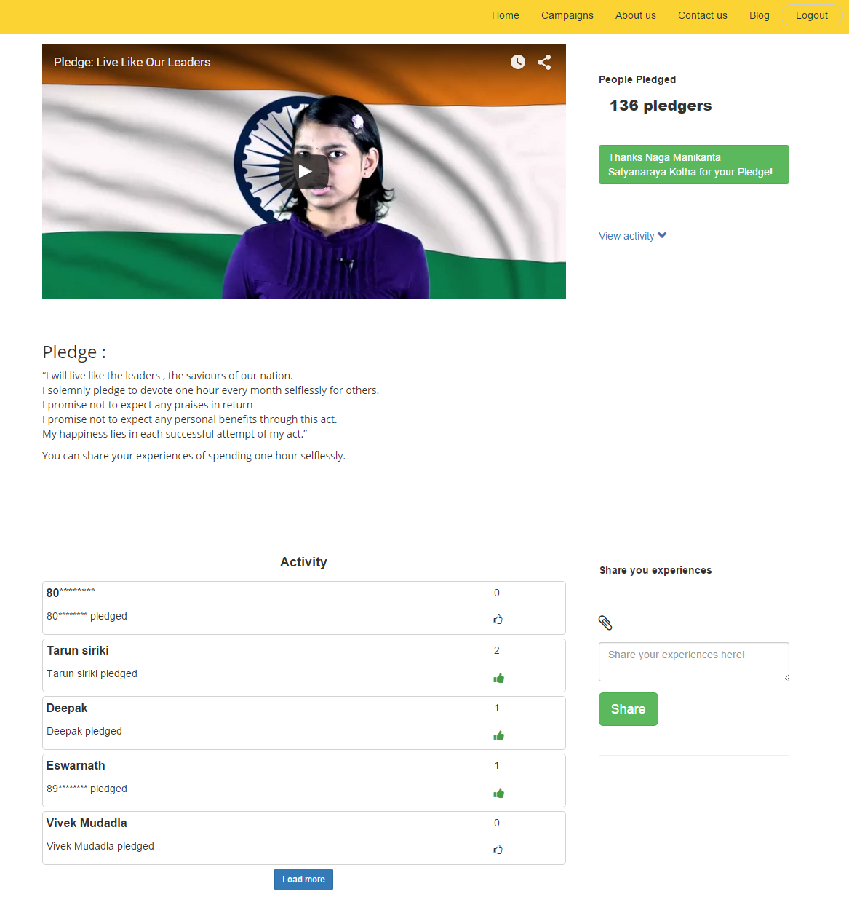
Place your screenshot here
Application User Interface
http://maketheworldwonderful.org

Slide 49
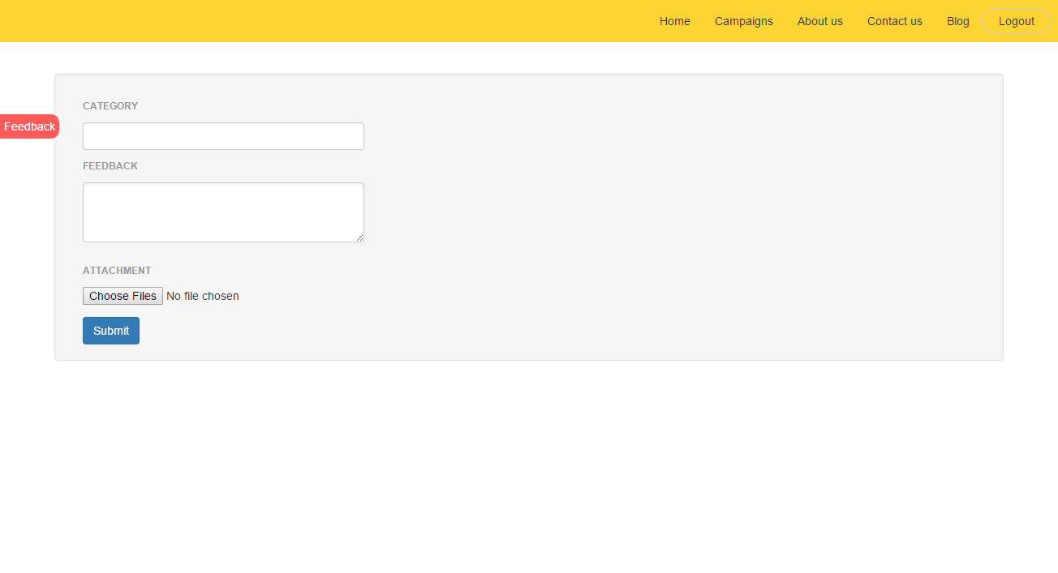
Application User Interface
http://maketheworldwonderful.org

Slide 50
Credits
Special thanks to all the people who made this endeavour a success.
Mr. Rahul Attuluri,
Director, CyberEye™ Research Labs & Security Solutions Pvt. Ltd.
Mr.Vasanth Sai,
Senior Software Developer, CyberEye™ Research Labs & Security Solutions Pvt. Ltd.
Mr. Ranjith Nori,
Software Developer, CyberEye™ Research Labs & Security Solutions Pvt. Ltd.

Slide 51
Thank You!
Any queries?

Slide 52
Teams**
Team 1 | Team 2 | Team 3
Kotha Naga Manikanta Satyanarayana | Venkata Abhinav Devaguptapu | Shaik Irfan
Tanuja Pala | Edara Naga Samyuktha | Sowmya Bezawada
Shaik Salma Sulthana | Karthik Gumpu | Mangaraju Velpula
Shobha Rani Potnuru | Rajasekhar Pantangi | Bheemasankar Babu
Susanth Pangi | Sivakotireddy Bandi

